Slide 1
Natural Language Processing (NLP)
Lecture 12: Evaluation Classifiers
Dr. Muhammad Taimoor Khan

Slide 2
Evaluation Techniques
Cross Validation
How to manipulate the training data
Performance Evaluation
How to evaluate models, compare them and pick a suitable one

Slide 3
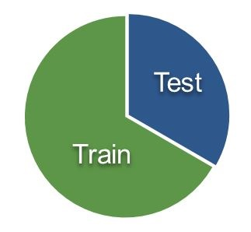
Cross validation
Used to train a model in a way to achieve good generalization
Divide the dataset
Training
Testing

Slide 4
Cross Validation Techniques
K-fold
Leave one out
Hold out

Slide 5
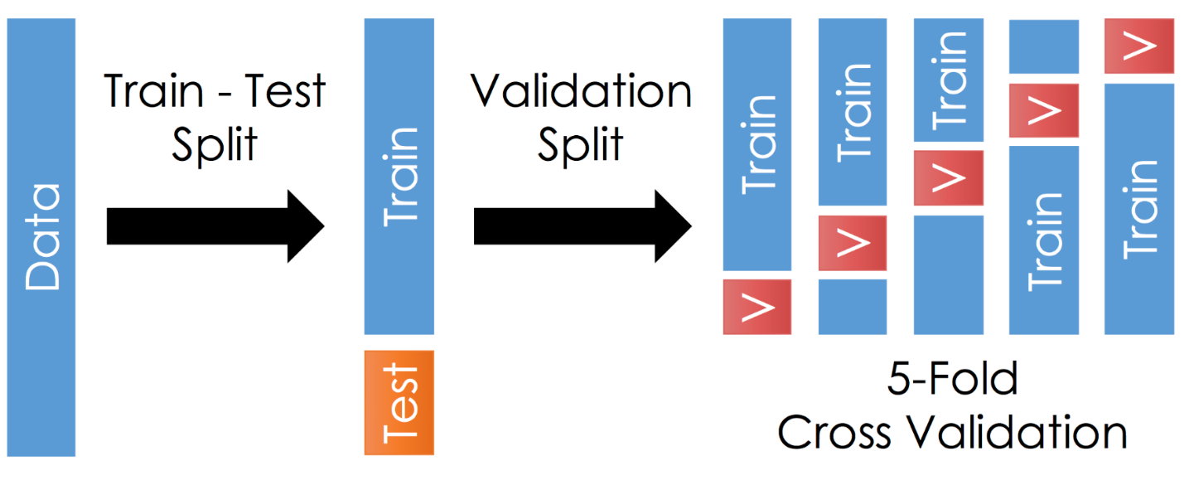
1. K-fold
Decide a value of K
e.g. K = 10 makes it 10-fold cross validation
Apply k-fold cross validation to tune model parameters
Train and Test Accuracy is averaged for K-folds

Slide 6
K-fold Algorithm
Shuffle the dataset randomly
Split the dataset into k groups
For each unique group:
Take the group as a hold out or test data set
Take the remaining groups as a training data set
Fit a model on the training set and evaluate it on the test set
Retain the evaluation score and discard the model
Average the model’s evaluation score

Slide 7
5 – Fold Cross Validation
K = 5
Insect ID | Abdomen Length | Antennae Length | Insect Class
1 | 2.7 | 5.5 | Grasshopper
2 | 8.0 | 9.1 | Katydid
3 | 0.9 | 4.7 | Grasshopper
4 | 1.1 | 3.1 | Grasshopper
5 | 5.4 | 8.5 | Katydid
6 | 2.9 | 1.9 | Grasshopper
7 | 6.1 | 6.6 | Katydid
8 | 0.5 | 1.0 | Grasshopper
9 | 8.3 | 6.6 | Katydid
10 | 8.1 | 4.7 | Katydids

Slide 8
Each data sample gets K-1 chances to get trained on
Each data sample gets a chance to be tested on
Performed for smaller datasets
Number of folds to be decided while training
many folds – large variance, extra computational cost
Few folds preferred for large training datasets

Slide 9
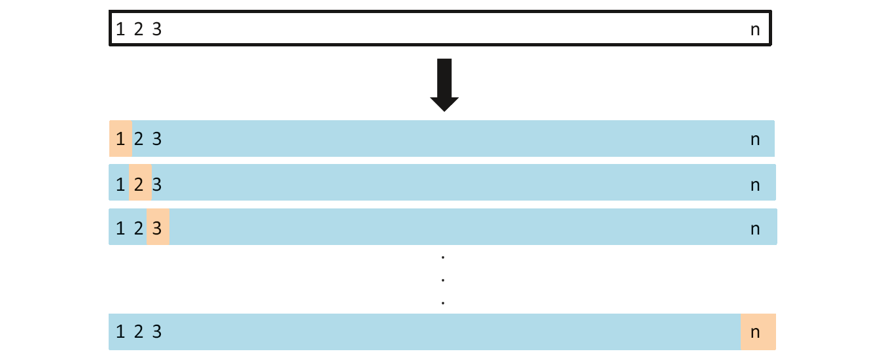
2. Leave one out
N-fold cross validation (where N is the total samples in data)
Special case of k-fold cross validation, having folds equal to number of data samples
Preferred when limited data available
Validation performance checked for each instance

Slide 10
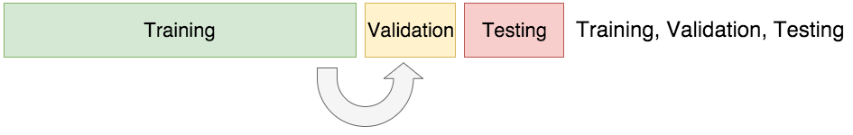
3. Hold Out
Used when sufficient training data available
No hard & fast rule about the portion for training, validation and testing
Validation data is used to tune the parameters of the model

Slide 11
Performance Evaluation
Predictive accuracy
Speed and scalability
time to construct the model
time to use the model
efficiency in disk-resident databases

Slide 12
Robustness
handling noise, missing values and irrelevant features, streaming data
Interpretability
understanding and insight provided by the model

Slide 13
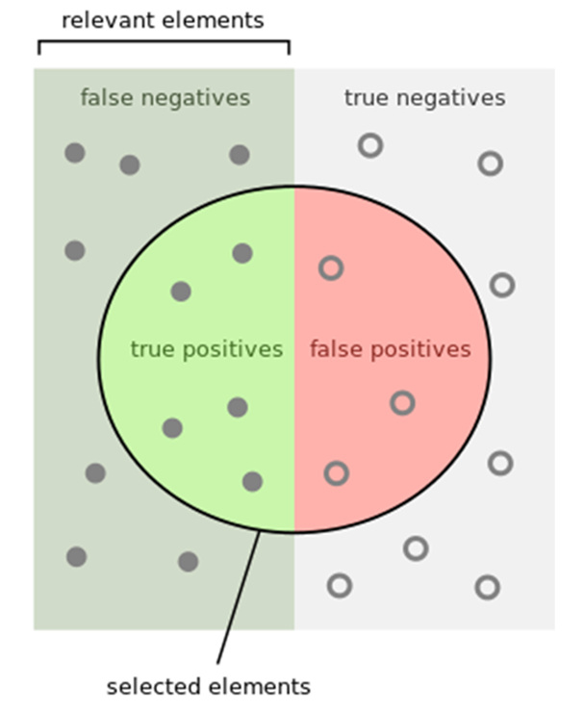

1. Predictive Accuracy
Using K-fold cross validation
Accuracy =
Number of correct classifications
Number of instances classified
$$Accuracy=\frac{tp+tn}{tp+tn+fp+ fn}$$

Slide 14
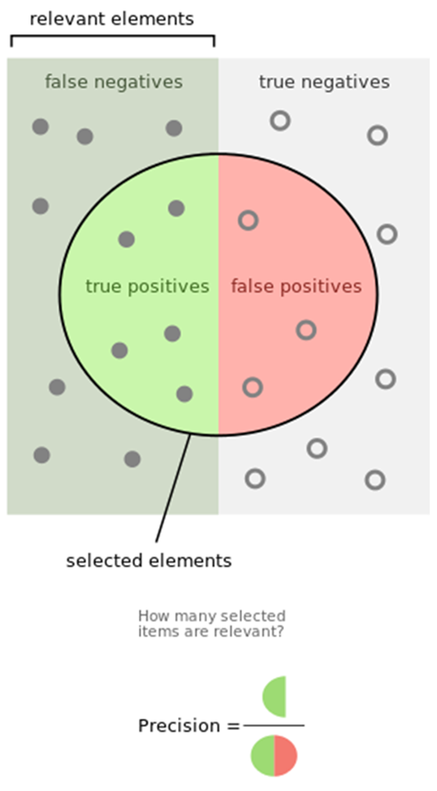

Precision
It’s a positive predictive value
It’s the fraction of relevant instances among the retrieved instances
$$Precision=\frac{|\{relevant_documents\}∩\{retrieved_documents\}|}{|\{retrieved_documents\}|}$$
$$Precision=\frac{tp}{tp+fp}$$

Slide 15
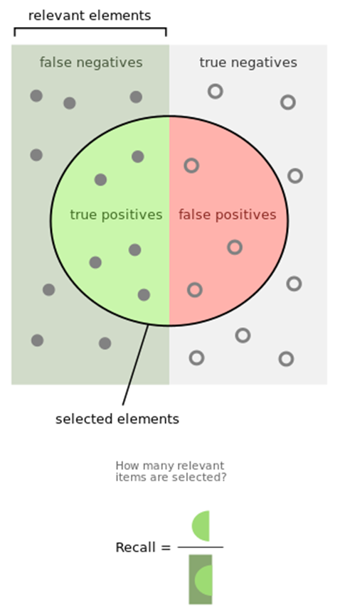
Recall
It’s the sensitivity
It’s the fraction of relevant instances retrieved over the total amount of relevant instances
$$Recall=\frac{|\{relevant_documents\}∩\{retrieved_documents\}|}{|\{relevant_documents\}|}$$
$$Recall=\frac{tp}{tp+fn}$$

Slide 16

F-measure or F1 score
It’s the harmonic mean of precision and recall
$$F1=\frac{2}{\frac{1}{recall}+\frac{1}{precision}}=2\frac{precision∙recall}{percision+recall}$$

Slide 17
Confusion Matrix
Accuracy is a single number, we may be better off looking at a confusion matrix. This gives us additional useful information…
True label is...
 | Cat | Dog | Pig
Cat | 100 | 0 | 0
Dog | 9 | 90 | 1
Pig | 45 | 45 | 10
Classified as a…

Slide 18
2. Speed and Scalability
We need to consider the time and space requirements for the two distinct phases of classification
Time to construct the classifier
The time taken to construct (train) the classifier
Time to use the model
The time taken to test (use) the model
As we shall see, some classification algorithms are very efficient in one aspect, and very poor in the other.

Slide 19
3. Robustness
We need to consider what happens when we have:
Noise
For example, a persons age could have been mistyped as 650 instead of 65, how does this effect our classifier?
This is important only for building the classifier, if the instance to be classified is noisy we can do nothing
Missing values
For example suppose we want to classify an insect, but we only know the abdomen length (X-axis), and not the antennae length (Y-axis), can we still classify the instance?

Slide 20
We need to consider what happens when we have:
Irrelevant features
For example, suppose we want to classify people as either
Suitable_Grad_Student
Unsuitable_Grad_Student
And it happens that scoring more than 5 on a particular test is a perfect indicator for this problem…
If we also use “hair_length” as a feature, how will this effect our classifier?
1
2
3
4
5
6
7
8
9
10
10
9
8
7
6
5
4
3
2
1
1
2
3
4
5
6
7
8
9
10

Slide 21
We need to consider what happens when we have:
Streaming data
For many real world problems, we don’t have a single fixed dataset. Instead, the data continuously arrives, potentially forever…
stock market, weather data, sensor data etc.
Can our classifier handle streaming data?

Slide 22
4. Interpretability
Some classifiers offer a bonus feature. The structure of the learned classifier tells use something about the domain.
As a trivial example, if we try to classify peoples health risks based on just their height and weight, we could gain the following insight (Based on the observation that a single linear classifier does not work well, but two linear classifiers do).
There are two ways to be unhealthy, being obese and being too skinny
Weight
Height

Slide 23
Home Quiz 3
Classifier:
16 = x₁ + 5x₂ + 3
x₁ + 5x₂ + 3<= 16 Grasshoppers
x₁ + 5x₂ + 3 > 16 Katydid
Perform 2-fold _{c}ross validation
Calculate predictive accuracy
Draw confusion matrix
Insect ID | Abdomen Length | Antennae Length | Insect Class
1 | 2.7 | 5.5 | Grasshopper
2 | 8.0 | 9.1 | Katydid
3 | 0.9 | 4.7 | Grasshopper
4 | 1.1 | 3.1 | Grasshopper
5 | 5.4 | 8.5 | Katydid
6 | 2.9 | 1.9 | Grasshopper
7 | 6.1 | 6.6 | Katydid
8 | 0.5 | 1.0 | Grasshopper
9 | 8.3 | 6.6 | Katydid
10 | 8.1 | 4.7 | Katydids

